Slide 1
Data Fest - Group 6
Abtahee Ali, Alex Gonzalez, Abraham Osman, Brittany Patriotis, Maleeha Shaikh, Mariacamila E.G., Tristin Jones, Wesley Morgan, and Ysa Ledesma

Slide 2

Question
Did COVID-19 decrease flight traffic (number of flights arrived) in the New York City area in December 2020 compared to December 2019? The following large airports were used for analysis:
John F. Kennedy International (JFK)
LaGuardia Airport (LGA)
Newark Liberty International (EWR)
Notes:
We are examining whether Covid 19 has affected the number of flights in the New York City Area between December 2019 and 2020. To determine the impact we analyzed the number of arriving flights. We compared data from JFK, LaGuardia, and Newark, the three busiest airports in the region.

Slide 3
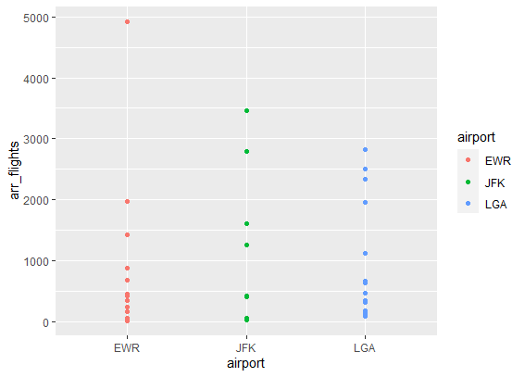
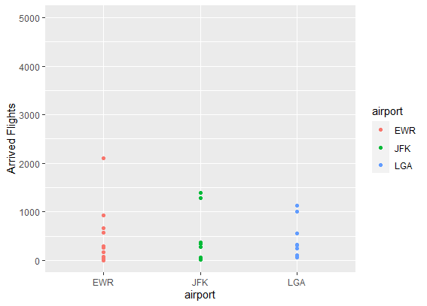
2019-2020 Scatter Plot Analysis
2019
2020
Notes:
ggplot(data=flights_2020)+
+ geom_point(mapping=aes(x=airport,y=arr_flights,color=airport))
ggplot(data=flights_2019)+
+ geom_point(mapping=aes(x=airport,y=arr_flights,color=airport))

Slide 4
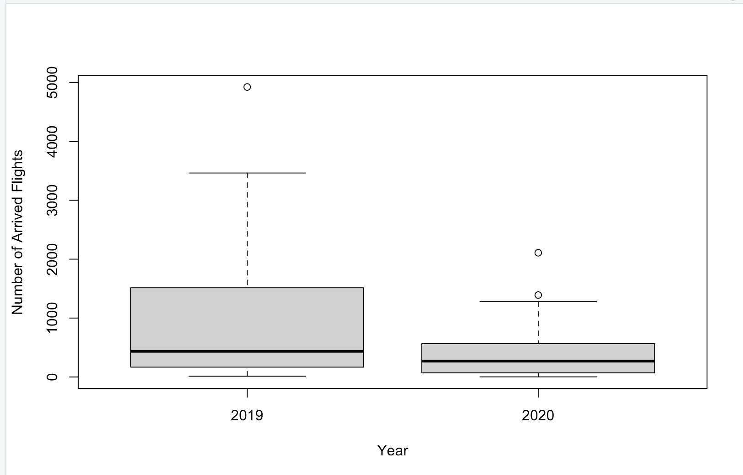
2019-2020 Boxplot Analysis
Notes:
flight<-filter(airline,airport == "JFK" | airport == "LGA" | airport == "EWR")
boxplot(flight$arr_flights~flight$year,ylab = "Number of Arrived Flights",xlab= "Year")

Slide 5
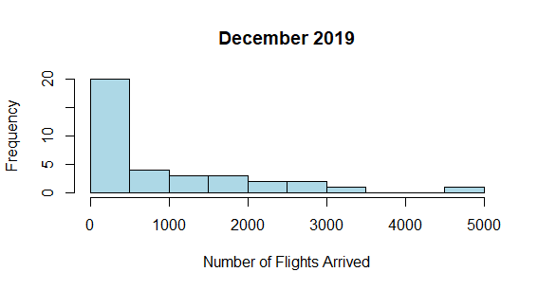
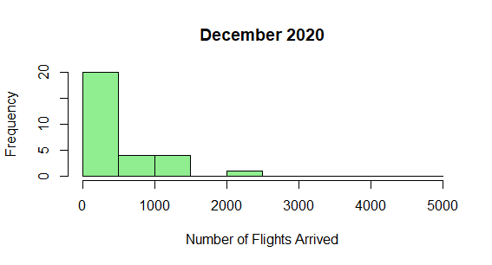
Histogram
Notes:
> F2019<-flights_2019$arr_flights
> F2020<-flights_2020$arr_flights
> min<-min(c(F2019,F2020))
> max<-max(c(F2019,F2020))
> ax<-pretty(min:max,n=12)
> h1<-hist(F2019,breaks = ax,plot=FALSE)
> h2<-hist(F2020,breaks = ax,plot=FALSE)
> plot(h1,col="lightblue",xlab = "Number of Flights Arrived",main = "December 2019")
> plot(h2,col="lightgreen",xlab = "Number of Flights Arrived",main = "December 2020")

Slide 6
Kruskal-Wallis Test
Model: Y = Θi + ε
Hypothesis:
Ho: Median number of flights arrived (Θi) in 2019 and 2020 are the same
Ha: At least one of the medians (Θi) is different (Θ2019 =/= Θ2020)
Assumptions:
Independent groups - these are different airports with different airlines
Independent observations - randomly picked NYC

Slide 7
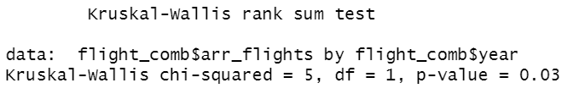
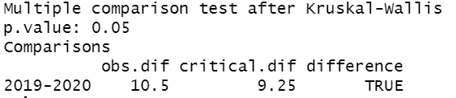
Kruskal-Wallis Test
Notes:
Speaker- Alex

Slide 8

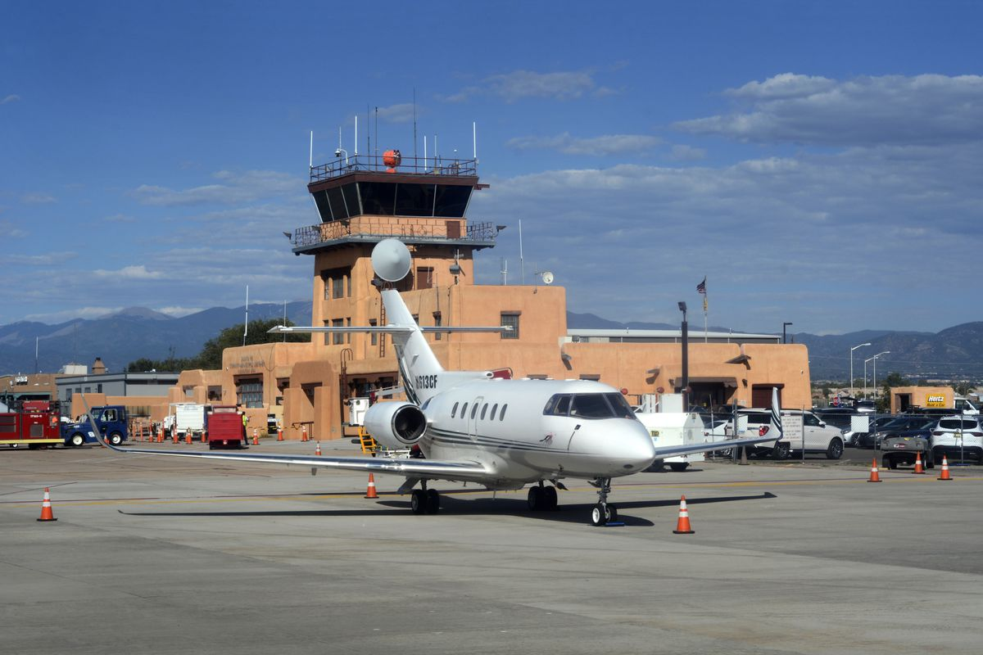
Conclusion & Analysis Limitations
Conclusion:
There is statistically significant evidence that COVID-19 did cause a decrease in the median number of flight arrivals for these 3 airports in New York in December 2020 compared to December 2019.
Limitations:
Empty flights ran through the pandemic.
Smaller airports not in the analysis.
Notes:
speaker : tristin

Slide 9
Thank You

